Slide 1
Sentiment Analysis on r/Drexel
What students discuss and and how they feel
Group 7
Elizabeth Evans, Isabel Enriquez, Katherine Wolfe, Nihar Shah, Nitya Patel

Slide 2
Our Research Question
What are students talking about on r/Drexel, and how do they feel about those topics?
• Reddit captures candid, real-time student discussion
• The data is too large and unstructured to read manually
• Topic modeling + sentiment analysis turn posts into usable patterns
2
Notes:
Nitya

Slide 3
Stakeholders
Who will benefit from this analysis?
• Drexel Administration: Since students do not fill out official surveys, allows administration to identify issues and get unfiltered feedback.
• Prospective Students: Make an objective decision by identifying good and bad things about the university.
• Current Students: Get answers to questions and understand if they are the only ones struggling with something or if it is a shared experience.
2
Notes:
Nitya

Slide 4
The Dataset
r/Drexel posts from subreddit creation through July 1, 2026
32,053
raw posts collected
22,132
posts after filtering
8,983
unique authors
• Removed deleted/removed posts and kept id, author, date, title, and selftext
• 5,526 authors posted only once
• Top 1% of authors produced 12.45% of posts
3
Notes:
Lizzie

Slide 5
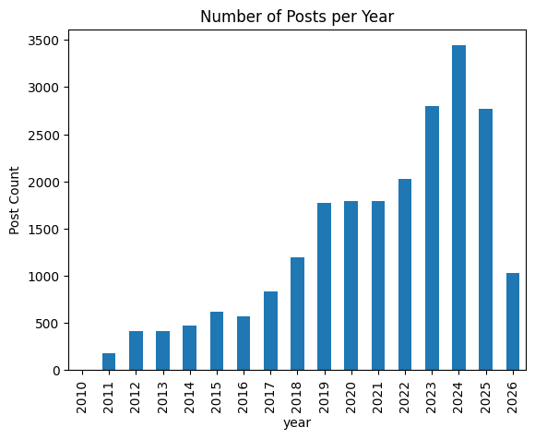
Posting Activity Grew Over Time
• Posting generally increased over the life of the subreddit
• 2024 was the highest-volume year in the notebook
• 2026 is only a partial year through July 1
4
Notes:
Nihar

Slide 6
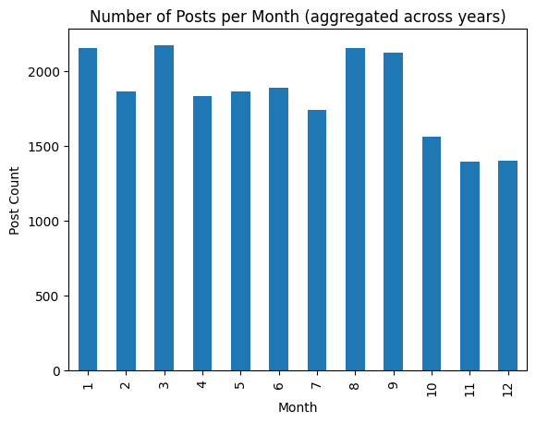
When Do Students Post?
• Posting peaks appear in January, March, August, and September
• The group hypothesizes that some peaks may line up with co-op and academic decision periods
• Activity is also highest from roughly early afternoon through late evening
5
Notes:
Nihar

Slide 7
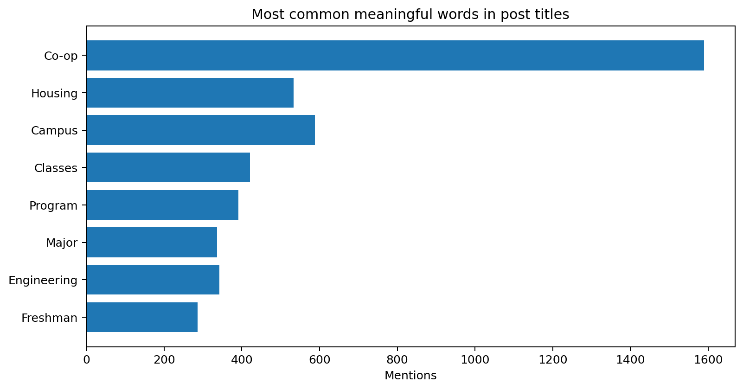
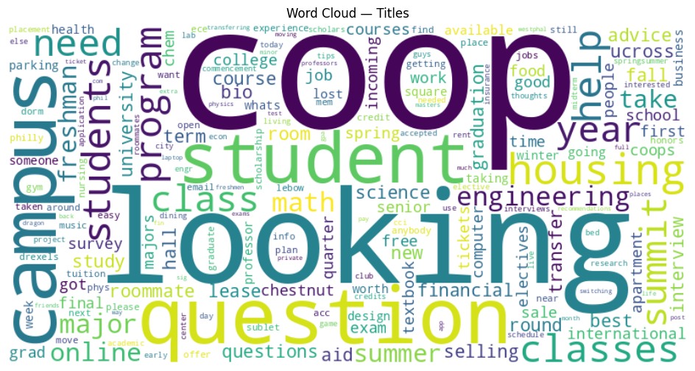
What Are Students Talking About?
“Co-op”
most common meaningful word in both titles and post text
• Other repeated themes: classes, housing, campus, majors, programs, and engineering
6
Notes:
Nihar

Slide 8
Topic Modeling: 7 Recurring Themes
LDA with K = 7; final notebook coherence ≈ 0.554
Campus & community
campus • club • food
2
Co-op & jobs
interview • job • coop
1
Programs & aid
program • financial • transfer
Housing
apartment • lease • roommate
3
4
Academics
class • course • professor
6
Marketplace
sell • ticket • buy
5
Communication
email • send • issue
7
7
Notes:
Isabel
For the topic modeling, we used LDA. Before we ran the model we had to clean and prepare the text by stripping out Reddit-specific noise, such as URLs and markdown formatting, tokenizing and lemmatizing the words and removing standard stopwords and a custom list of words specific to our corpus. Things like “Drexel” itself, which showed up in nearly every post and added no distinguishing value.
We then tested the model across a range of topic counts, from 2 up to 25, and evaluated each using a coherence score, which measures how semantically related the top words in each topic are to each other. The coherence scores ended up fairly flat across the lower range, so rather than picking purely based on that number, we manually reviewed the resulting topics at each level and chose the topic count that produced the clearest, most distinct, and most interpretable set of themes — which ended up being 7."
The final model surfaced seven clear topics: campus life and student activities, co-op and career, admissions and financial aid, off-campus housing, academics and coursework, a marketplace category for buying and selling items, and a cluster around emails and technical or administrative issues.
What stood out to us is that the two largest, most distinct topics were housing and co-op/career — which makes sense given Drexel's identity as a co-op-heavy university. We also didn't expect the marketplace topic to emerge as its own separate theme, but it clearly reflects a real, organic use of the subreddit by students.

Slide 9
Sentiment Analysis with VADER
Positive
compound ≥ 0.05
What the code does
• Combines each post title + selftext
• Calculates negative, neutral, positive, and compound scores
• Assigns a sentiment label to every post
Neutral
−0.05 < compound < 0.05
Negative
compound ≤ −0.05
8
Notes:
Katie

Slide 10
Why We Chose VADER
Naive baseline
Counted a short list of positive and negative words, then labeled ties as neutral
VADER model
Uses polarity strength, negation, punctuation, and common social-media wording
Why it matters
Reddit posts are informal, sarcastic, and often mixed in tone
53.8%
agreement with VADER
0.285
Cohen’s kappa
12,458
posts naive called neutral
6,071
disagreements with negation
Main point: the naive model overused “neutral,” while VADER captured more real positive and negative signals.
9
Notes:
Katie

Slide 11
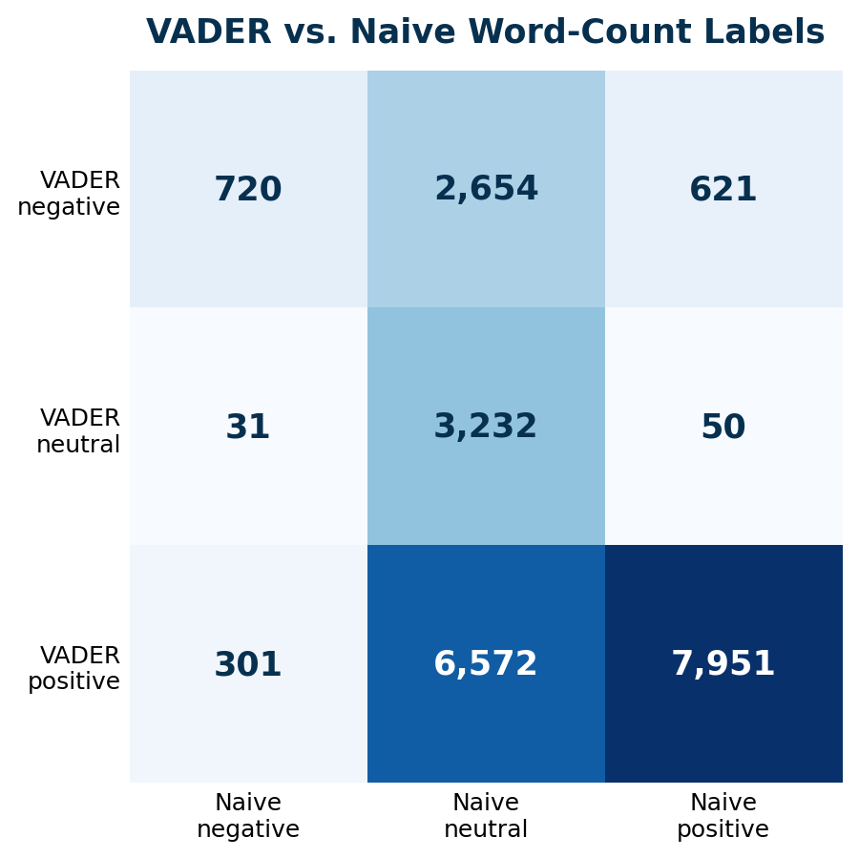
Naive Word Counts Missed Sentiment
9,226
VADER non-neutral posts that naive labeled neutral
• Naive missed many posts without exact dictionary words
• Negation changed meaning: “not,” “never,” “without,” and “no.”
• VADER was better for informal Reddit language
10
Notes:
Katie

Slide 12
Examples
Where do you guys find parking? I'm over near Powelton Avenue and I'm sick of getting parking tickets because I can never find a spot and end up in some temporary spot too long.\n\nWhere do you guys usually park? Or do you use Drexel Parking?\n\nThanks.
Naive Model: Positive, VADER: Negative (more accurate)
Somehow some way Drexel makes housing even sh**** for upperclassman. my girlfriend just got an email from housing, shes gonna live in caneris, and she's gonna have a freshman stay in her suite in addition to her five other roommates, meaning the suite . for those counting at home she now has 7 people in her room, one of the rooms is a triple. she is kinda pi****.
Naive Model: Neutral, VADER: Negative (more accurate)
The people who hog the Buckley soccer field every evening... I never see them anywhere else... in hallways, on campus, or in class...\n\nI'm not keeping an eye out for them directly but hopefully what I'm saying is understood.\n\nI see them arrive in cars, play, then leave. So they are either commuters (that I somehow don't see anywhere on campus) or not Drexel students (someone lets them in?)\n\nEither way it's kinda annoying when other people want to play soccer or any other sport (they always take up the whole field too)\n\n</rant>
Naive Model: Negative (more accurate), VADER: Positive
9
Notes:
Katie

Slide 13
Next Steps and Future Research
• Compare sentiment across all 7 LDA topics to identify where student experiences are most positive or negative
• Validate a sample of posts by hand to measure VADER accuracy, especially for sarcasm, slang, and mixed tone
• Track topic and sentiment changes over time to connect shifts with academic, co-op, and housing cycles
• Use a stronger context-aware sentiment model as a comparison to VADER and report where the models disagree
• Translate recurring negative themes into specific areas Drexel can investigate through more targeted surveys or student outreach
9
Notes:
Lizzie

Slide 14
Key Takeaways
• r/Drexel provides a large, candid source of student discussion that complements traditional feedback methods
• Co-op, academics, housing, and campus life are recurring concerns that can be organized into clear themes with LDA
• VADER captures more sentiment than the naive word-count approach, but sarcasm and informal language still create errors
• Combining Topic × Sentiment is the strongest next analysis because it shows not only what students discuss, but how they feel about each issue
• With validation and time-based analysis, these findings can better support administrators, current students, and prospective students
Final takeaway: Topic + sentiment can turn unstructured Reddit posts into useful signals for decision-making
9
Notes:
Lizzie

